Slide 1
STEPS TO ACCESS STUDENT RECORDS, ATTENDANCE, IEPS AND EMPLOYEE EVALUATION

Slide 2
USE GOOGLE CHROME

Slide 3
https://grant.sis.k12.wv.us

Slide 4
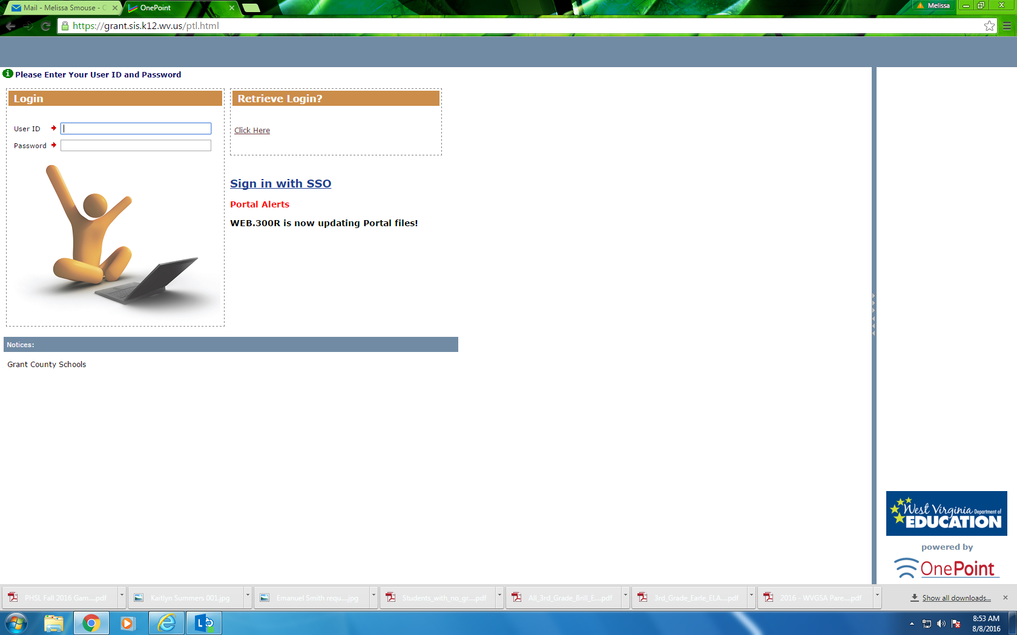

Slide 5
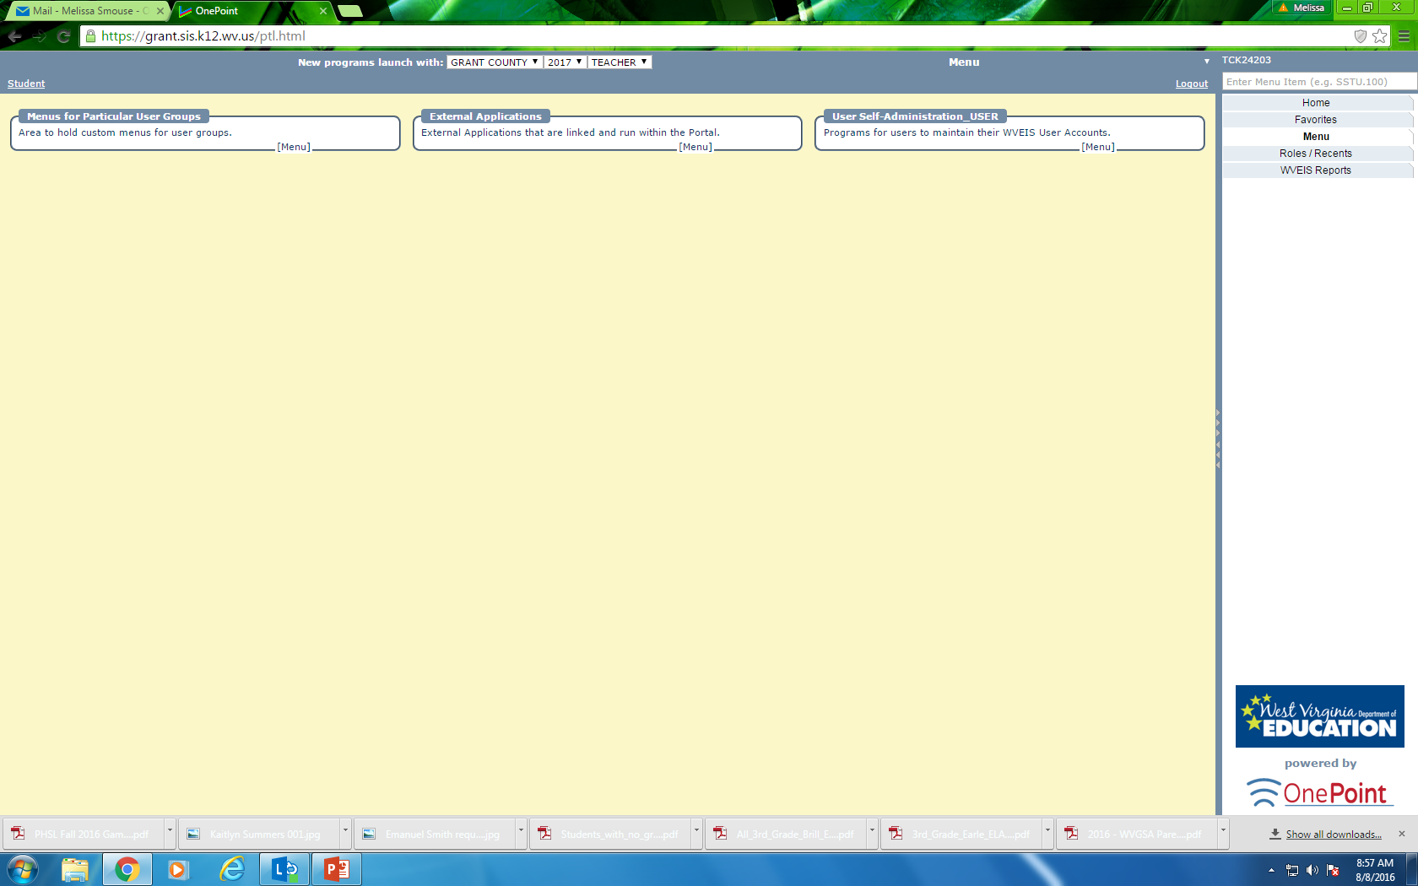

Slide 6
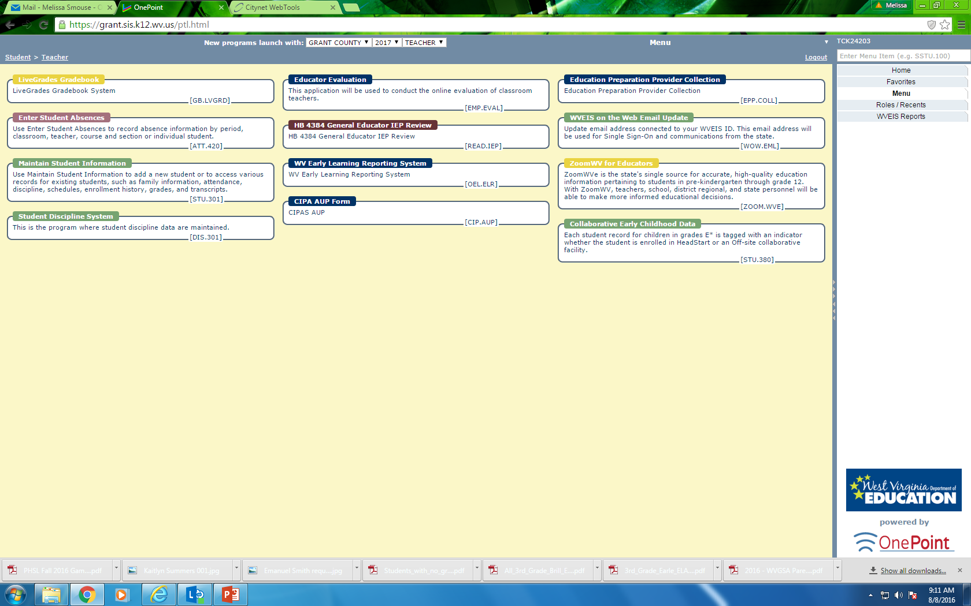

Slide 7
TO ACCESS STUDENT INFORMATION

Slide 8


Slide 9
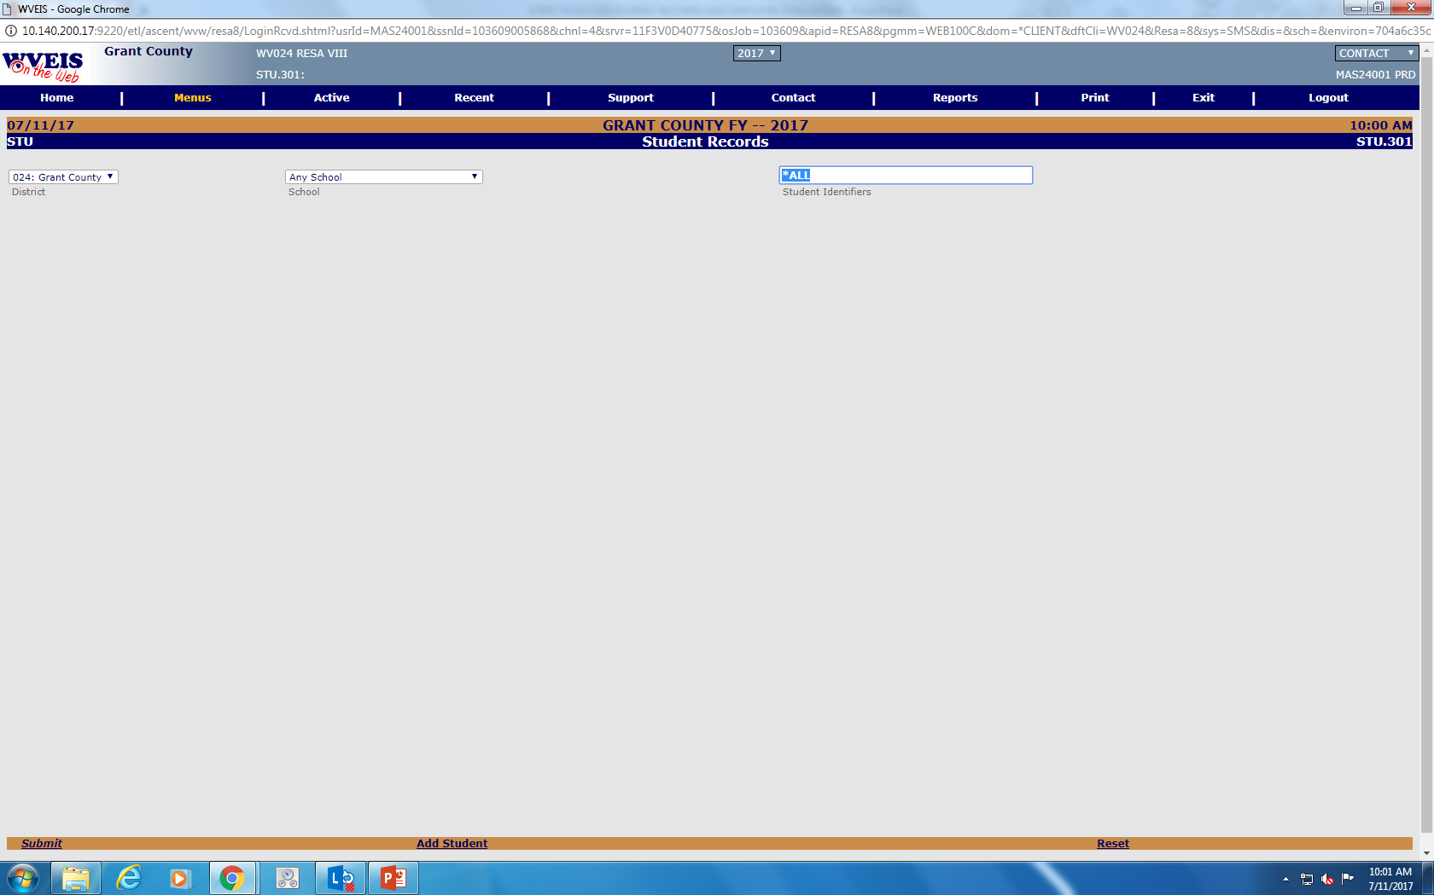
To search for your student enter identifying information such as first or last name.
Submit
You will only have access to those students in your classes

Slide 10
TO ACCESS THE EMPLOYEE EVALUATION SYSTEM

Slide 12
TO ACCESS AND READ IEPS

Slide 14
IT MAY TAKE SOME TIME
TO LOAD

Slide 15
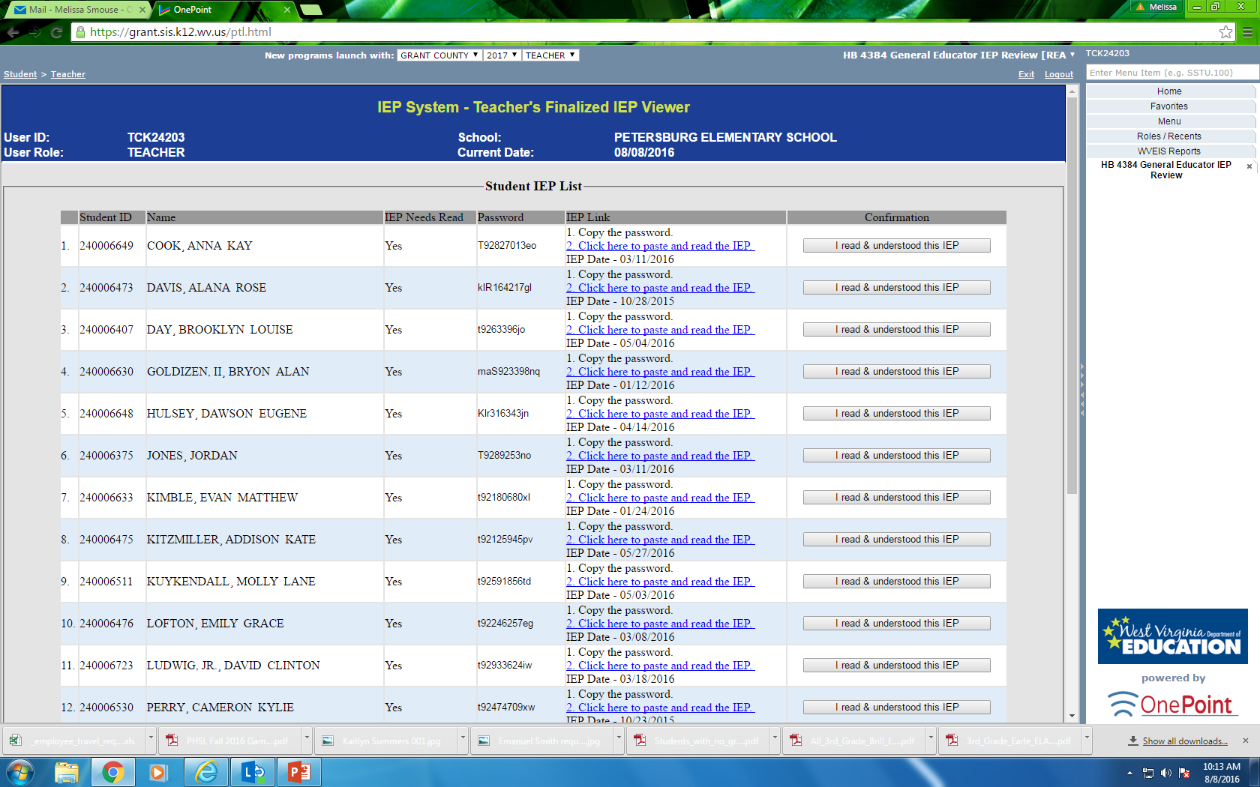
You will need to copy the password to paste in the next screen before selecting to read the IEP.

Slide 16
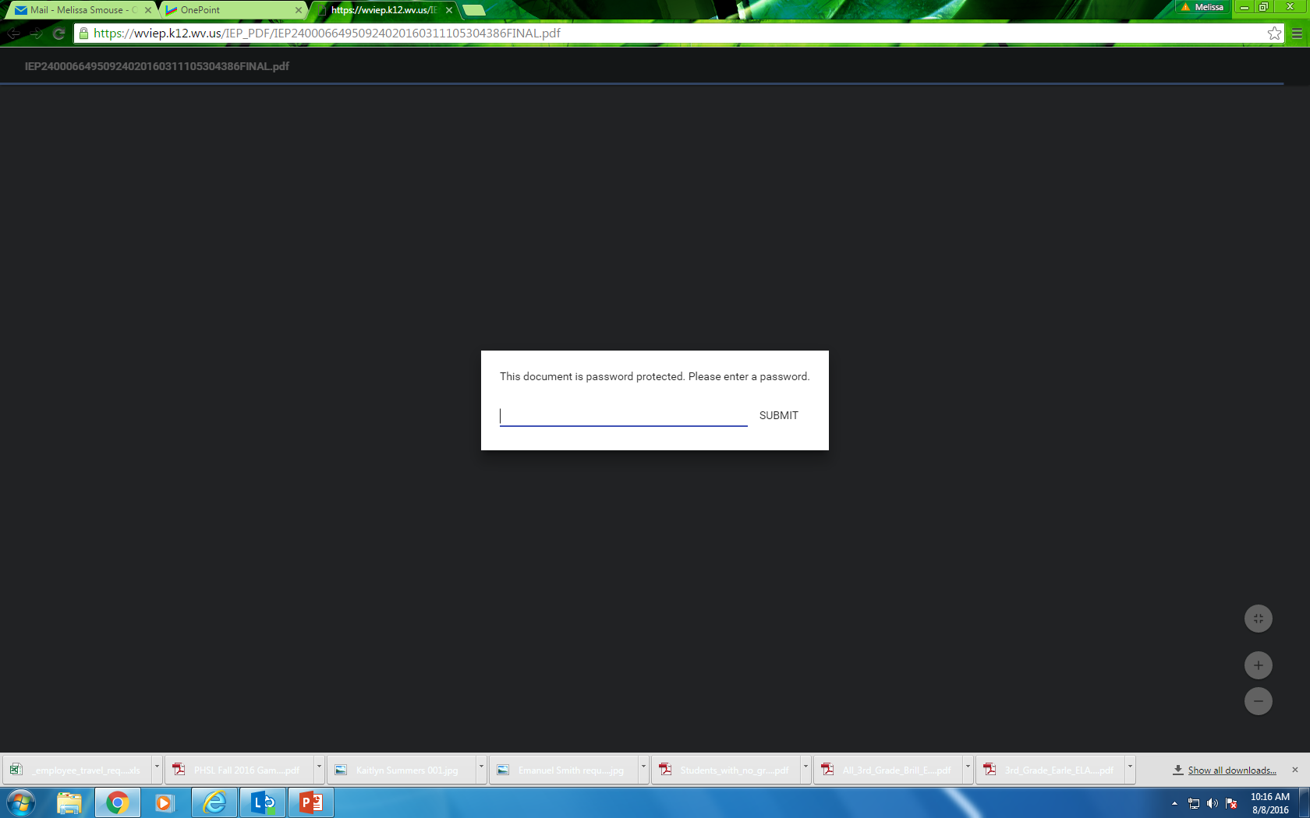
1. Insert Copied Password Here.
(Each IEP will have a unique password)
2. The IEP will then pop up for you to read.
3. When you are finished close this screen. You will return to your previous IEP viewer screen in WOW.

Slide 17

Select that you have read and understood the IEP. Do this for each student

Slide 18
REMEMBER:
IEPS ARE CONFIDENTIAL
AND PROTECTED BY FEDERAL LAW!!!

Slide 19
IT IS YOUR RESPONSIBILITY TO CHECK AND READ NEW IEPS WHEN THEY ARE WRITTEN

Slide 20
YOU WILL RECEIVE
ACCOMODATION VERIFICATION SHEETS
FOR 504/IEP/SAT STUDENTS
TO FILL OUT AND RETURN TO YOUR
SPED DESIGNEES

Slide 21
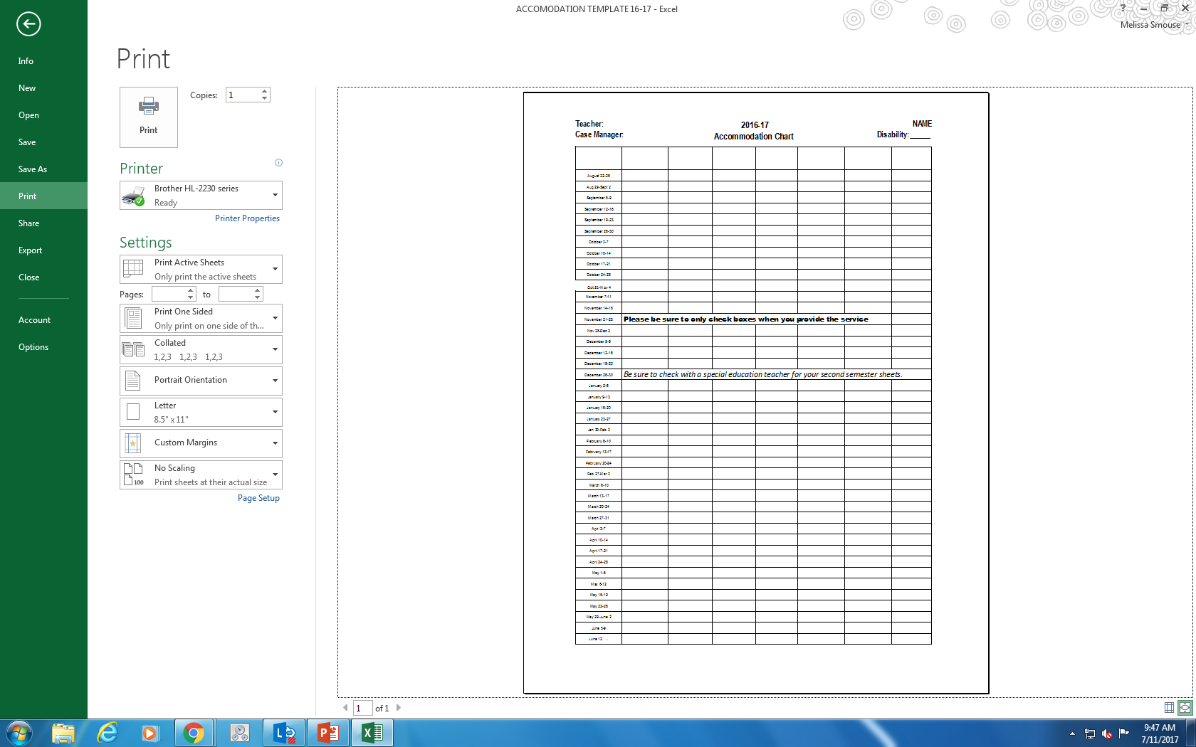

Slide 22
IF YOU HAVE ANY QUESTIONS
ABOUT THE IEPS
OR
STUDENTS’ NEEDS
CONTACT YOUR BUILDING
SPECIAL EDUCATION TEACHER
OR
SPEECH LANGUAGE PATHOLOGIST

Slide 23
IF YOU HAVE ANY QUESTIONS
ABOUT THE 504s or SAT PLANS
CONTACT YOUR BUILDING
ADMINISTRATOR
OR
SAT COORDINATOR

Slide 24
To Access & Enter Attendance

Slide 25
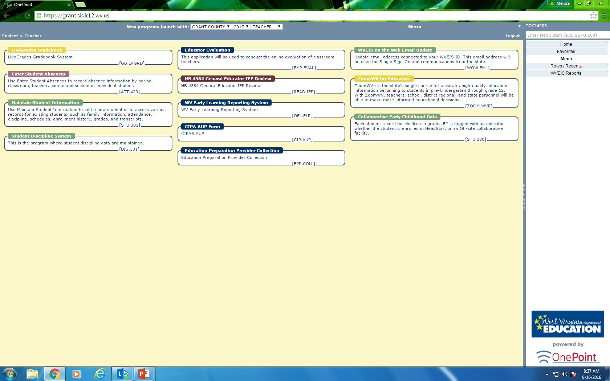

Slide 26
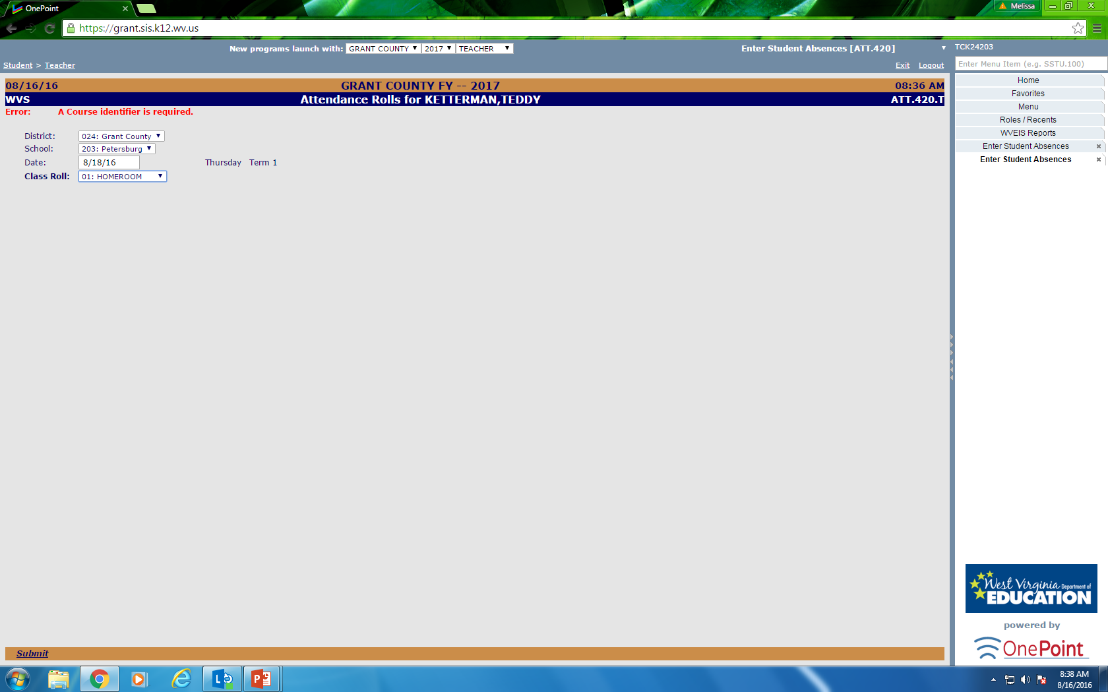
Select the class you need to take attendance for. Remember this is only for the 1st time you see students that day. All other attendance is not to be take here.

Slide 27
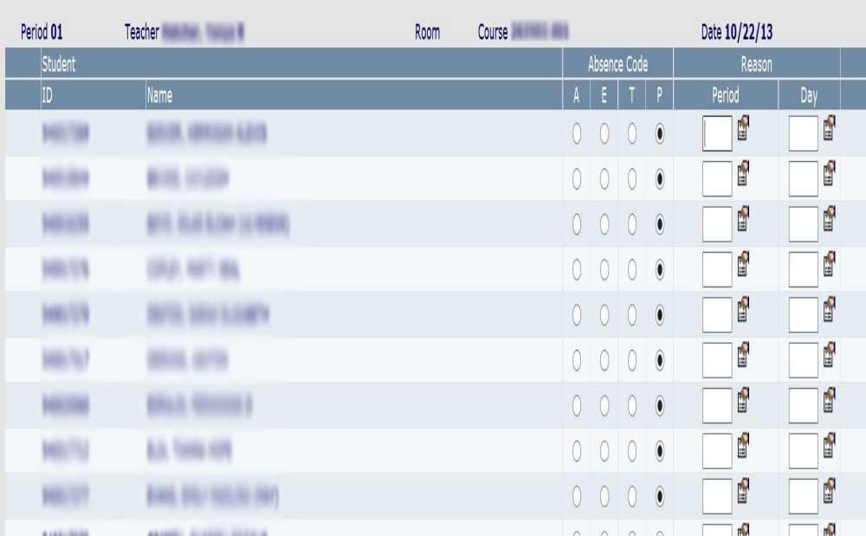
Default to Present (P)
ONLY MARK (A) if Absent or (T) if Tardy

Slide 28
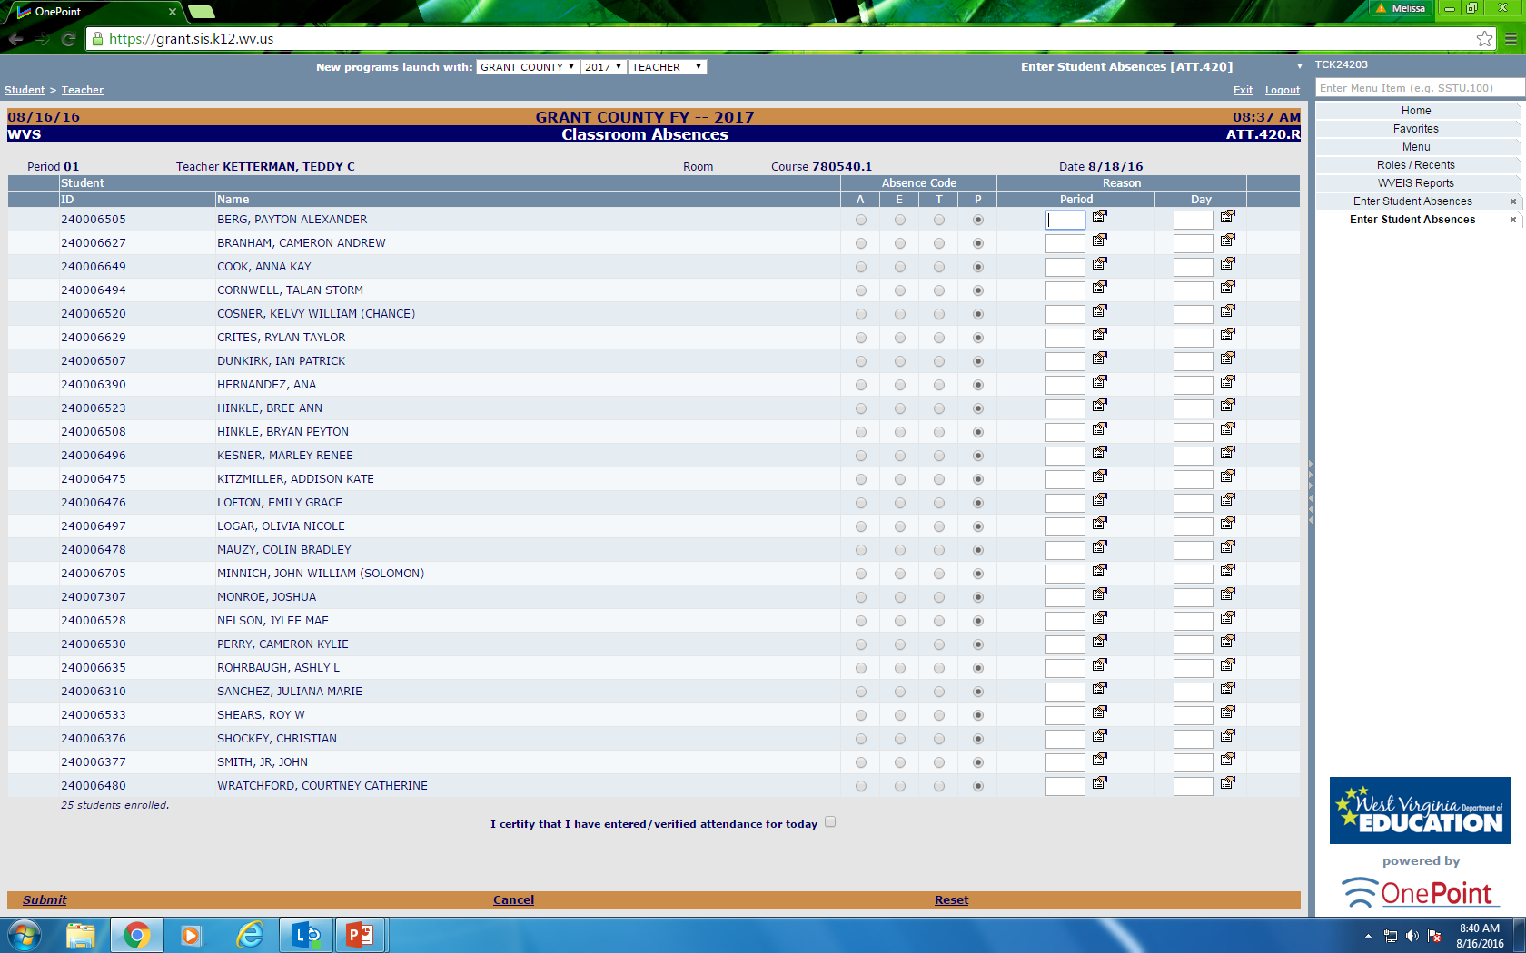
1. Certify Your attendance for the day even if no one is absent.
2. Select Submit & Your Finished.

Slide 29
CERTIFICATION MUST BE COMPLETED BY 8:30 am!!!
ONCE YOU CERTIFY DO NOT GO IN AND CHANGE STUDENTS THAT MAY ARRIVE LATE. THOSE TARDIES/ABSENCE CHANGES WILL BE ADJUSTED BY THE OFFICE STAFF.

Slide 30
IF YOU HAVE ANY
OPERATIONAL QUESTIONS CONTACT
MELISSA SMOUSE
304-257-1011 OFFICE
304-851-0943 CELL/TEXT
MSMOUSE@K12.WV.US

